Slide 1
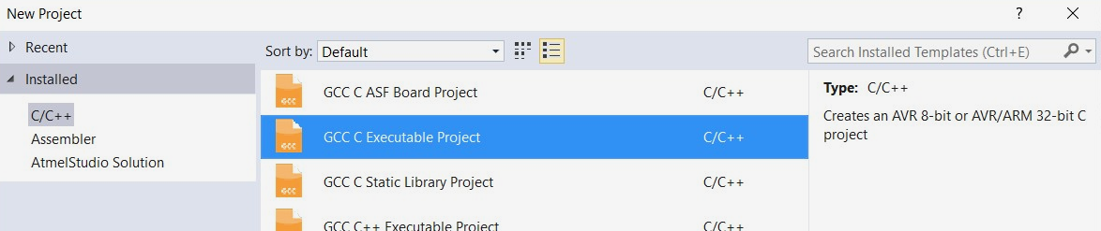
C Project
Ensure you select the ‘GCC C Executable Project’ type

Slide 2
ADC
You will need to use ADC in this lab
There are three registers that need to be set for each task
  ADCSRA
  ADCSRB
  ADMUX – this is set in the readADC() function, as we have multiple ADC channels to read
Refer to Lab 4 PowerPoint and content for information
Notes:
Or, you can refer to last weeks lab tasks to jog you memory over the ADC.

Slide 3
LCD Display
This week will require using the 20x4 Alphanumeric display
  Review the contents of your lab manual to see how this is setup
  The example on Page 24 is a good example to refer to
Call these functions in your setup()
  SLCDInit() – This will initiate the TWI serial protocol to allow your μC to talk to the LCD
  SLCDDisplayOn() – This will turn on the display to show characters
  SLCDClearScreen() – This will clear the screen of any existing content (such as the last students code)
The LCD is split into a 20 x 4 grid
  The top-left cell is position 0,0
  Use the SLCDSetCursorPosition(y,x) function to set the cursor position
  Use the SLCDWriteString(charArrayToWrite) function to place text on the screen
  The text needs to be in the form of a char array (use the sprintf() function)
Hello World!
PA2
PA1
PA0
x
y
H | E | L
0,0
1,2

Slide 4
sprintf Function
// Example of using the sprintf function
char line0[20];
sprintf(line0, "temperature - %3d",tempSensorValue);
‘line0’ is the char array in which the string will be stored in
  This should be defined prior (as per the example above), and we set this to a blank array of 20 char values (since each line of the display can only show 20 characters)
‘temperature - %3d’ is the string we want to convert to show on the display
  %3d indicates that we intend to reserve three (‘3’) spaces for a decimal number (‘d’) to be displayed
‘tempSensorValue’ is the number we plan to substitute in this location
  The space we reserved earlier will be replaced by a 3-digit decimal number
Multiple variables can be used for the sprintf function
  See your lab manual for more information

Slide 5
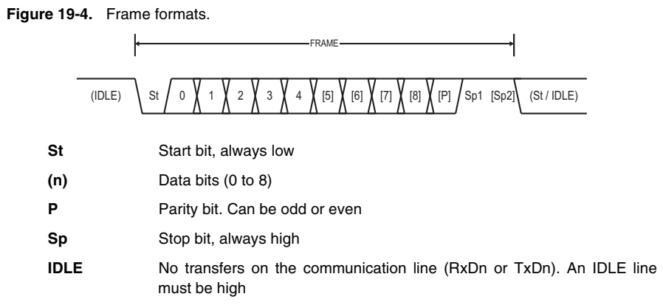
USART – Data Packet
Microchip AT90USB1287 Datasheet

Slide 6
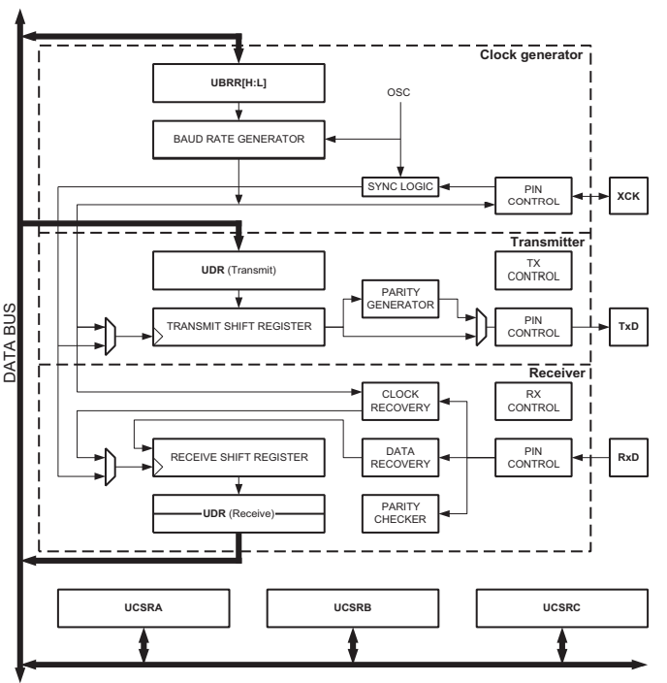
USART – Send Process
Data is placed into the UDRn register
  This automatically starts the transmit process
  This data is shifted into the Transmit Shift Register
  Once the data is placed into the Shift Register, the UDRE flag on UCSRnA is set to a 1
  The USART Tx Control is activated
‘Start Bit’ is sent by the USART
  This is simply pulling down the line (0)
‘Data Bits’ are sent
  Each Data bit is sent out of the Transmit Shift Register
  The data bit is sent out over the TxD pin
  The data bit is also sent to the parity generator to calculate the parity bit
‘Parity Bit’ is sent
  The parity bit calculated during the transmission of the data bit is sent out over the TxD pin
‘Stop Bit(s)’ are sent
  The TXCn flag in the UCSRnA register is set to a 1
Microchip AT90USB1287 Datasheet
Notes:
Best to view these with animations (Start Slideshow)

Slide 7
USART – Send Process
Data is placed into the UDRn register
Once the data is placed into the Shift Register, the UDRE flag on UCSRnA is set to a 1, indicating new data can be placed into the UDRn register
The TXC flag in the UCSRnA register is set to a 1 to indicate the data transmission has been complete
Notes:
From a code standpoint

Slide 8
USART – Receive Process
‘Start Bit’ received by the USART
  This is simply pulling down the line (0)
  The USART Rx Control is activated and starts listening
‘Data Bits’ are received
  Each Data bit is transferred into the Receive Shift Register
  This is a holding spot until all the data bits are received by the USART
‘Parity Bit’ is received
  The USART automatically performs the calculation to check the integrity of the data
  If there is an issue with the data, the UPE flag from the UCSRnA register is set to a 1
‘Stop Bit’ is received
  At this point, the data will shift into the UDRn register
  The RXC flag in the UCSRnA register is set to a 1
Microchip AT90USB1287 Datasheet
Notes:
Best to view these with animations (Start Slideshow)

Slide 9
USART – Receive Process
The RXC flag in the UCSRnA register is set to a 1 to indicate the data has been received
If there are any issues with the integrity of the data (based on the calculation of the parity checker), the UPE flag from the UCSRnA register is set to a 1
Read the data from the UDRn Register
Notes:
From a code standpoint

Slide 10
Setting USART Registers
When setting the UBRR register, simply define it as equal to the number stated on the Baud Rate Register table
  There is no need to convert and enter in the number as a decimal or hexadecimal value!
  The μC uses a 8MHz clock and we will not be using the double transmission speed for USART (U2X bit on UCSRnA)
// Set the UBBR1 register using the
number
UBRR1 = 51;
Notes:
Pages 8 – 12 in your Microcontroller Register Reference Guide

Slide 11
Setting up USART on the Lab Board
MIC
RH
UART
ETH
Ensure that the selector switches are set to the correct setting for each problem
  Locate these under the seven-segment displays
  For Problem 2 (Loopback), set the switch to LOOP
  For Problem 4 (PC Communication), set the switches to UART & USB
POT1
POT2
LOOP
USB
PC3
PC2
PC1
PC0

